Slide 1
OS’24 Project
Milestone 2: MEMORY
KERNEL HEAP, USER HEAP, Sharing & FAULT HANDLER I

Slide 2

Agenda
Logistics
Part 0: Code Updates
Part 1: Kernel Heap
Block Allocator
Page Allocator
Part 2: Fault Handler I
Part 3: User Heap
Block Allocator
Page Allocator
Part 4: Shared Memory
Summary & Quick Guide
How to submit?

Slide 3

Logistics
Dependency:
MS1: dynamic allocator (alloc_block_FF & free_block)
Delivery Method: GOOGLE FORMS
It’s FINAL delivery
MUST deliver the required tasks and ENSURE they’re worked correctly
Delivery Dates:
THU of Week #9 (28/11 @11:59 PM)
Upload your code EARLY as NO EXCEPTION will be accepted.
Support:
The support for teams will be through their MENTORS ONLY (+Lecturer) during via:
MAIN METHOD: weekly office hours.
SECONDARY METHOD [OPTIONAL]: other contact method [MUST declare your Team# first]

Slide 4
Logistics
ADVICE#1: WORK AS A TEAM
Milestone 2: MEMORY
Kernel Heap: 6 functions
Fault Handler I: 3 functions
User Heap: 6 functions
Shared Mem: 6 functions
ADVICE#2: START immediately!
To have the chance to ask and to understand errors in your code in whatever you want during your mentor’s support before the deadline.
ADVICE#3: MUST read the ppt & doc CAREFULLY
Detailed steps
Helper ready made functions (appendices)
MUST be finished FIRST
Expected: Before MT
≈ 3~4 Functions/member
on 3 Weeks
L1 ➔ 9 FUNCTIONS - L2 ➔ 10 FUNCTIONS - L3 ➔ 2 FUNCTIONS

Slide 5
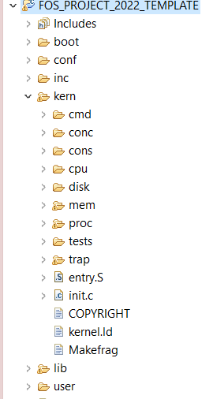




PROJECT BIG PICTURE
inc (.h)
Kern Heap
User Heap
Shared Mem
lib (.c)
Shared Mem
Fault Handler
[MS1] Preprocessing
user
Kern Heap
kern
User Heap
[MS2] MEMORY
User Heap
Shared Mem
[MS3] CPU
Fault Handler I
User Heap
Shared Mem

Slide 6
Code Updates
PART0: PREREQUISITES

Slide 7
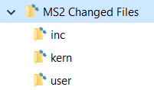
New Files
SELECT ALL in the given “Changed files” folder,
COPY & PASTE (REPLACE ALL) in FOS_CODES/FOS_PROJECT_2024_TEMPLATE/
NOTE: If any of these files are already edited by you in MS1, make sure to apply the edits in the new files

Slide 8

Given Codes
APPENDICES:
ENTRY MANIPULATION in TABLES and DIRECTORY
PAGE FILE HELPER FUNCTIONS
WORKING SET STRUCTURE & HELPER FUNCTIONS
MEMORY MANAGEMENT FUNCTIONS
COMMANDs

Slide 9
Given Codes
MEMORY MANAGEMENT FUNCTIONS: [Detailed Explanation in Lab#3]
Function | Description
PDX(uint32 virtual address) | Gets the page directory index in the given virtual address (10 bits from 22 – 31).
PTX(uint32 virtual address) | Gets the page table index in the given virtual address (10 bits from 12 – 21).
ROUNDUP(uint32 value, uint32 align) | Rounds a given “value” to the nearest upper value that is divisible by “align”.
ROUNDDOWN (uint32 value, uint32 align) | Rounds a given “value” to the nearest lower value that is divisible by “align”.
tlb_invalidate (uint32* directory, uint32 virtual address) | Refresh the cache memory (TLB) to remove the given virtual address from it.
isKHeapPlacementStrategyFIRSTFIT() | Check which strategy is currently selected using the given functions.

Slide 10

Given Codes
MEMORY MANAGEMENT FUNCTIONS: [Detailed Explanation in Lab#4]
Function Name | Description
allocate_frame | Used to allocate a free frame from the free frame list
free_frame | Used to free a frame by adding it to free frame list
map_frame | Used to map a single page with a given virtual address into a given allocated frame, simply by setting the directory and page table entries
get_page_table | Get a pointer to the page table if exist
create_page_table | Create a new page table by allocating a new page at the kernel heap, zeroing it and finally linking it with the directory
unmap_frame | Used to un-map a frame at the given virtual address, simply by clearing the page table entry
get_frame_info | Used to get both the page table and the frame of the given virtual address

Slide 11
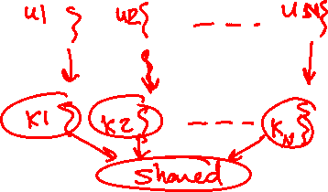
CAUTION
During your solution, any SHARED data need to be PROTECTED by critical section via LOCKS
REMEMBER: Ensure CORRECTNESS by DESIGN

Slide 12

Agenda
Logistics
Part 0: Code Updates
Part 1: Kernel Heap
Block Allocator
Page Allocator
Part 2: Fault Handler I
Part 3: User Heap
Block Allocator
Page Allocator
Part 4: Shared Memory
Summary & Quick Guide
How to submit?

Slide 13
Kernel Heap
The main functions required by MS2 to handle “Kernel Heap” are:
# | Function | File
1 | Initialization | All essential declarations in: Kern/mem/kheap.h Functions definitions TO DO in: Kern/mem/kheap.c
2 | sbrk()
3 | kmalloc (using FIRST FIT)
4 | kfree
5 | kheap_virtual_address
6 | kheap_physical_address
MS2 BONUS 1 | krealloc (using FIRST fit)
MS2 BONUS 2 | Fast Page Allocator

Slide 14
Kernel Heap
IMPORTANT NOTE
Before starting in the KHEAP functions, you MUST DO the following:
- Go to 'inc/memlayout.h' and set USE_KHEAP by 1

Slide 15


Kernel Heap – What is new?
Current:
Kernel is one-to-one mapped to 256 MB RAM
Kernel can’t directly access beyond 256 MB RAM
Problem:
Virtual Memory
4 GB
Physical Memory
FOS
256 MB
RAM
UP TO 4 GB
KERNEL_BASE
256 MB
0

Slide 16


Kernel Heap – What is new?
Example:
Kernel can’t directly access beyond 256 MB RAM
Because it is NOT
valid VA..
New_PT1
VA = KERNEL_BASE +512 MB!!
.
.
.
256 MB
New PT0
VA = KERNEL_BASE + 20 KB
New DIR
VA = KERNEL_BASE + 16 KB
PA = 512 MB
New PT1
Frame#131,072
.
.
.
KERNEL_BASE
PA = 20 KB
New PT0
Frame#5
PA = 16 KB
New DIR
Frame#4
Program’s Virtual Memory
PA = 0
RAM

Slide 17

Kernel Heap – What is new?
Solution:
Kernel Heap for dynamic allocations (No 1-1 map)
KERNEL’S TABLES
ptr_page_directory
PT#984
1023
Empty
984
Kernel Heap
500000
0
0
F#4
New PT0
VA = KHS + 4K
984
0
0
New DIR
VA = KHS
PA = 2 GB
NEW PT0
Frame#500,000
Index of Kernel Heap PT
KERNEL_BASE
.
.
.
.
.
.
PA = 16 KB
New DIR
Frame#4
KHS = KERNEL_HEAP_START
RAM
Program’s Virtual Memory

Slide 18

Kernel Heap – What is new?
KERNEL_HEAP_MAX
4 GB
KHEAP
KERNEL_HEAP_START
Kernel Heap lies at the end of the virtual space
256 MB
USTACKTOP
USTACKBOTTOM

Slide 19

Kernel Heap – Allocation Types?
There’re TWO types of allocator
Block Allocator
Used to allocate small blocks (with size LESS OR EQUAL DYN_ALLOC_MAX_BLOCK_SIZE)
Use Dynamic Allocator from MS#1
Range: [KERNEL_HEAP_START, HARD_LIMIT)
Page Allocator
Used to allocate chunk of pages (with size > DYN_ALLOC_MAX_BLOCK_SIZE )
Allocation is done on page boundaries (i.e. internal fragmentation)
Range: [HARD_LIMIT + PAGE_SIZE, KERNEL_HEAP_MAX)
KERNEL_HEAP_MAX
…
KERNEL HEAP
Page Allocator Area
HARD LIMIT + 4KB
HARD LIMIT
Block Allocator Area
KERNEL_HEAP_START
…

Slide 20


Kernel Heap – Block Allocator
Has 3 limits:
Start: begin of the dynamic allocator area
Break: end of current mapped area
Hard Limit: which the break can’t surpass
Break can only be changed using sbrk()
Use Dynamic Allocator with its data structure
Allocated
Free
size
a
F
size
f
F
Padding
Payload
prev ptr
next ptr
size
a
H
size
f
H
HARD LIMIT
Block Allocator Area
KERNEL_HEAP_START
…

Slide 21

#1: KH Block Alloc Initialization
Description:
Need to keep track of 3 variables for the kernel dynamic allocator:
start,
segment break (end of the allocated space) and
hard limit (max limit that can’t be exceeded).
These should be declared in the kern/mem/kheap.h.
Initialize the 3 variables, together with the dynamic allocator itself inside:
int initialize_kheap_dynamic_allocator(…) defined in kern/mem/kheap.c
This function, in turn, is already called inside the FOS_initialize() in init.c

Slide 22

#1: KH Block Alloc Initialization
int initialize_kheap_dynamic_allocator(uint32 daStart, uint32 initSizeToAllocate, uint32 daLimit);
Description:
Initialize the block allocator of kernel heap with the given start address, size & limit
All pages in the given range should be allocated and mapped
Remember: call the initialize_dynamic_allocator(..) to complete the initialization
Return:
On success: 0
Otherwise (if no memory OR initial size exceed the given limit): kernel should panic()
Testing:
Will be tested during the other tests…

Slide 23

#2: sbrk()
void* sbrk(int numOfPages);
Description:
Since virtual address space is mapped in quanta of pages (multiple of 4KB).
sbrk always increase the size by multiple of pages
If increment > 0: if within the hard limit
move the segment break of the kernel to increase the size of its heap by the given numOfPages,
allocate pages and map them into the kernel virtual address space as necessary,
returns the address of the previous break (i.e. the beginning of newly mapped memory).
If increment = 0: just return the current position of the segment break
if no memory OR break exceed the hard limit: it should return -1

Slide 24

#2: sbrk()
void* sbrk(int numOfPages);
In alloc_block_FF() of MS#1, after calling sbrk():
If it returns -1, the function should return NULL
Else:
The END block need to be moved to the new location
allocate(2KB)
➔Sbrk(1)
0/1
0/1
1KB
2KB
2KB
1.5KB – 8B
1KB
0.5KB
4KB
freeBlockList

Slide 25

#2: sbrk()
void* sbrk(int numOfPages);
In alloc_block_FF() of MS#1, after calling sbrk():
If it returns -1, the function should return NULL
Else:
The END block need to be moved to the new location
If there’s a free block at the end of the old break, it should be coalesced with the new space
Allocate the required space
allocate(2KB)
➔Sbrk(1)
2KB
0/1
0/1
1KB
2KB
2KB
1.5KB – 8B
1.5KB
4KB
5.5KB
3.5KB
freeBlockList

Slide 26
#2: sbrk()
void* sbrk(int numOfPages);
In alloc_block_FF() of MS#1, after calling sbrk():
If it returns -1, the function should return NULL
Else:
The END block need to be moved to the new location
If there’s a free block at the end of the old break, it should be coalesced with the new space
Allocate the required space
Testing:
FOS> tst kheap FF sbrk ➔ tests sbrk & the changes in alloc_block_FF

Slide 27
Kernel Heap – Page Allocator
Should start at one-page after the block allocator limit
Allocation is done on page boundaries (multiple of 4KB)
i.e. internal fragmentation can occur
All required pages should be allocated & mapped by OS
Allocation Strategy: FIRST FIT
KERNEL_HEAP_MAX
…
KERNEL HEAP
Page Allocator Area
HARD LIMIT + 4KB
KERNEL_HEAP_START
…

Slide 28

Kernel Heap – Page Allocator
Kmalloc(): dynamically allocate space
Kfree(): delete a previously allocated space
Kfree()
Remove ALL Pages BUT NOT Tables
kmalloc()
ALL Pages Created in Memory
KERNEL HEAP
RAM
HARD LIMIT + 4KB

Slide 29

Kernel Heap – Page Allocator
Allocate pages on 4KB granularity
.
.
.
ptr3 = kmalloc (3 KB)
ptr3
3 KB
ptr2 = kmalloc (1 KB)
ptr2
1 KB
2 KB
4 KB
ptr1 = kmalloc (6 KB)
ptr1
HARD LIMIT + 4KB
.
.
.

Slide 30

Kernel Heap – Page Allocator
.
.
.
KERNEL_HEAP_MAX
2 MB
FIRST FIT Strategy
.
.
.
ptr4 = kmalloc (2 MB)
2 MB
ptr4
1 MB
3 MB
4 MB
ptr2 = kmalloc (3 MB)
ptr2
2 MB
ptr3 = kmalloc(1 MB)
ptr3
1 MB
3 MB
ptr1 = kmalloc (1 MB)
ptr1
1 MB
4 MB
In kmalloc, you need to check which strategy is currently selected to apply its code using the given functions: isKHeapPlacementStrategyFIRSTFIT(), isKHeapPlacementStrategyBESTFIT(), …
HARD LIMIT + 4KB
.
.
.

Slide 31

Kernel Heap – Page Allocator
kheap_physical_address(): find physical address of the given kernel virtual address
kheap_virtual_address(): find kernel virtual address of the given physical one
IMP: Both MUST be Efficient ~O(1)
kheap_physical_address()
Get pa of the given va
kheap_virtual_address()
Get va of the given pa
KERNEL HEAP
RAM
pa
pa
va
va

Slide 32

#3: kmalloc()
void* kmalloc(unsigned int size)
Description:
If size ≤ DYN_ALLOC_MAX_BLOCK_SIZE: [BLOCK ALLOCATOR]
Use dynamic allocator with FIRST FIT to allocate the required space
Else: [PAGE ALLOCATOR]
Allocate & map the required space on page-boundaries using FIRST FIT strategy
If failed to allocate: return NULL
Testing:
FOS> tst kheap FF kmalloc 1 ➔ tests allocation only
FOS> tst kheap FF kmalloc 2 ➔ tests FF strategy#1 [PAGE Alloc.] (depends on kfree) [always FIT]
FOS> tst kheap FF kmalloc 3 ➔ tests FF strategy#2 [PAGE & BLOCK] (depends on kfree) [FIT & NOT]

Slide 33
#4: kfree()
void kfree(void* virtual_address)
Description:
If virtual address inside the [BLOCK ALLOCATOR] range
Use dynamic allocator to free the given address
If virtual address inside the [PAGE ALLOCATOR] range
FREE the space of the given address from RAM
Else (i.e. invalid address): should panic(…)
Testing:
FOS> tst kheap FF kfree

Slide 34

#5: kheap_physical_address()
unsigned int kheap_physical_address(unsigned int virtual_address)
Description:
return the physical address corresponding to given virtual_address (including offset)
If no mapping, return 0.
It should work for both [BLOCK ALLOCATOR] and [PAGE ALLOCATOR]
It should run in O(1)
Testing:
FOS> tst kheap FF kphysaddr

Slide 35

#6: kheap_virtual_address()
unsigned int kheap_virtual_address(unsigned int physical_address)
Description:
return the virtual address corresponding to given physical_address (including offset)
If no mapping, return 0.
It should work for both [BLOCK ALLOCATOR] and [PAGE ALLOCATOR]
It should run in O(1)
Testing:
FOS> tst kheap FF kvirtaddr

Slide 36
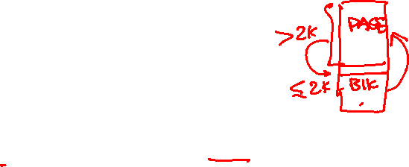
BONUS#1: krealloc()
void *krealloc(void *virtual_address, uint32 new_size)
Description:
Attempts to resize the allocated space at given virtual address to "new size" bytes, possibly moving it in the heap.
If successful, returns the new virtual address.
On failure, returns a null pointer, and the old virtual address remains valid.
A call with virtual_address = null is equivalent to kmalloc()
A call with new_size = zero is equivalent to kfree()
It should work for both [BLOCK ALLOCATOR] and [PAGE ALLOCATOR]
Testing:
[UNSEEN] test at your own

Slide 37

BONUS#2: Fast Page Allocator
Description:
Efficient implementation of the Page Allocator using suitable data structures
Testing:
FOS> tst kheap FF fast
[Should run in LESS THAN 5 sec]

Slide 38

Kernel Heap – Testing
"test [TEST NAME] completed. Evaluation = …%”
To ensure the success of a test, this message like this MUST be appeared without any ERROR messages or PANICs.
Test each function independently in a FRESH SEPARATE RUN.
The time limit of each individual test: max of 15 sec / each
Before testing any of the kheap functions: Go to 'inc/memlayout.h' and set USE_KHEAP by 1
Function | Testing | Files
Initialization | Will be tested during the other tests | kern/mem/kheap.h & .c
sbrk() | FOS> tst kheap FF sbrk ➔ tests sbrk & allocate | kern/mem/kheap.c
kmalloc (FIRST FIT) | FOS> tst kheap FF kmalloc 1 ➔ tests allocation only FOS> tst kheap FF kmalloc 2 ➔ tests FF in PAGE Alloc FOS> tst kheap FF kmalloc 3 ➔ tests FF in PAGE & BLK 2 & 3 depend on kfree | kern/mem/kheap.c
kfree | FOS> FOS> tst kheap FF kfree
kheap_virtual_address | FOS> FOS> tst kheap FF kvirtaddr
kheap_physical_address | FOS> FOS> tst kheap FF kphysaddr

Slide 39

Kernel Heap – Testing
Dependency Graph:
Dynamic Allocator
Test sbrk
Test kmalloc 1
Test kfree
Test kheap virtual addr.
Test kheap physical addr.
Test kmalloc 2
Test kmalloc 3
REMEMBER: This module MUST be FINISHED 1st

Slide 40
Agenda
Logistics
Part 0: Code Updates
Part 1: Kernel Heap
Block Allocator
Page Allocator
Part 2: Fault Handler I
Part 3: User Heap
Block Allocator
Page Allocator
Part 4: Shared Memory
Summary & Quick Guide
How to submit?

Slide 41
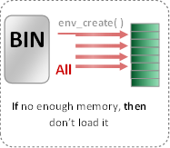

Load Program [env_create]
Now: in Project
THREE kernel dynamic allocations:
create_page_table(): create new page table and link it to directory.
create_user_directory(): create new user directory.
create_user_kern_stack(…): create new user kernel stack.
Prev: in Labs
env_create( )
BIN
Set of pages
Required Tables
DONE
All Pages
BIN
Segment 1, page 1
Loaded in virtual address 201000
201000
WS_Last_element
Segment 1, page 2
Loaded in virtual address 202000
202000
REQUIRED
Segment 1, page 3
203000
Loaded in virtual address 203000
Segment 2, page 1
801000
Refer to APPENDICES for:
Loaded in virtual address 801000
Segment 2, page 2
USTAKTOP —PAGESIZE
NOT Loaded in main memory
Page File Helper Functions
Program Binary Segments and pages
Working Set after loading (pages_WS_size = 5)
First Stack Page
Working Set Structure & Helper Functions

Slide 42
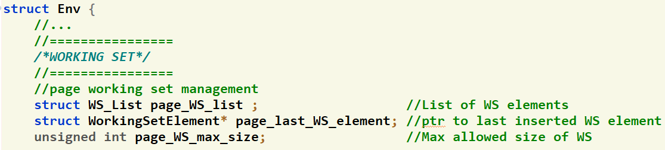
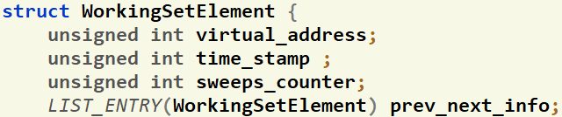

Working Set: Structure
inc/environment_definitions.h
Each Element
FIFO & CLK
Proc Limit
inc/environment_definitions.h
Each process has a working set LIST that is initialized in env_create()
Its max size is set in "page_WS_max_size" during the env_create()
"page_last_WS_element" will point to either:
the next location in the WS after the last set one If list is full.
Null if the list is not full.
This list hold pointers to struct containing info about the currently loaded pages in memory.
Each struct holds two important values about each page:
User virtual address of the page
Previous & Next pointers to be used by list

Slide 43

Working Set: Functions [GIVEN]
void env_page_ws_print(struct Env* e)
Print the page working set virtual addresses together with used, modified & buffered bits.
It also shows where the page_last_WS_element of the working set is point to

Slide 44

Working Set: Functions [GIVEN]
void env_page_ws_invalidate(struct Env* e, uint32 virtual_address)
Search for the given virtual address inside the working set of “e” , if found:
Remove its WS element from the list
Delete this element from the kernel memory (using kfree())

Slide 45

#7: Kernel Dynamic Allocations for a Process
void* create_user_kern_stack(uint32* ptr_user_page_directory)
struct WorkingSetElement* env_page_ws_list_create_element(struct Env* e, uint32 virtual_address)
Description:
Create a user kernel stack of size KERNEL_STACK_SIZE
Mark its bottom page as NOT PRESENT (GUARD page)
Return
On success: pointer to the created stack
On failure: kernel should panic()
Testing:
Will be tested during the next tests…
Description:
Create a new object of struct WorkingSetElement
Initialize it by the given virtual address
Return
On success: pointer to the created object
On failure: kernel should panic()
Testing:
Already tested in next placement test

Slide 46
Fault Handler I: Overview
The main functions required to handle “Page Fault” are:
# | Function | File
1 | fault_handler | Functions definitions TO DO in: kern/trap/fault_handler.c
2 | page_fault_handler

Slide 47

Fault Handler I: Overview
Fault: is an exception thrown by the processor (MMU) to indicate that:
A page table is not exist in the main memory (i.e. new table). (see the following figure) OR
A page can’t be accessed due to either it’s not present in the main memory

Slide 48

#8: Check Invalid Pointers
void fault_handler(struct Trapframe *tf)
Description:
Validate the faulted_va to ensure that it is :
NOT pointing to UNMARKED page in user heap
NOT pointing to kernel
Exist but with read-only permissions
If invalid: it must be rejected without harm to the kernel or other running processes, by exiting the process using env_exit()
Testing:
FOS> run tia 15

Slide 49
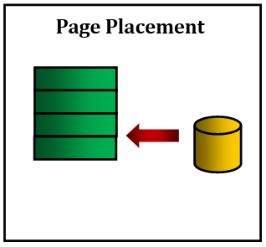

#9: Placement
page_fault_handler(struct Env * falulted_env, uint32 fault_va)
If the size of the page working LIST < its max size, then do (refer to appendices for helper functions)
Scenario 1: Placement
Allocate space for the faulted page
Read the faulted page from page file to memory
If the page does not exist on page file, then
If it is a stack or a heap page, then, it’s OK.
Else, it must be rejected without harm to the kernel or other running processes, by exiting the process.
Reflect the changes in the page working set list (i.e. add new element to list & update its last one)
Testing:
FOS> run tpp 20
NOTE: Check MS2 appendices to handle either the working set or the page file using some ready-made functions.

Slide 50

Fault Handler I: Testing
Test each function in MS3 independently in a FRESH SEPARATE RUN
The time limit of each individual test: max of 10 sec / each
"test [TEST NAME] completed. Evaluation = …%”
To ensure the success of a test, this message like this MUST be appeared without any ERROR messages or PANICs.
# | Test Functionality | Test
1 | tst_placement.c (tpp): tests page faults on stack + page placement | FOS> run tpp 20
2 | tst_invalid_access.c (tia): tests invalid pointers | FOS> run tia 15

Slide 51
Agenda
Logistics
Part 0: Code Updates
Part 1: Kernel Heap
Block Allocator
Page Allocator
Part 2: Fault Handler I
Part 3: User Heap
Block Allocator
Page Allocator
Part 4: Shared Memory
Summary & Quick Guide
How to submit?

Slide 52
User Heap
The main functions required by MS2 to handle “User Heap” are:
# | Function | File
1 | Initialization | All essential declarations in: inc/uheap.h Functions definitions TO DO in: lib/uheap.c
2 | sys_sbrk()
3 | malloc() (using FIRST FIT) [USER SIDE]
4 | free() [USER SIDE]
5 | allocate_user_mem [KERNEL SIDE] | Kern/mem/chunk_operations.c
6 | free_user_mem [KERNEL SIDE]
MS2 BONUS 3 | free_user_mem: O(1) for removing pages from WS List

Slide 53
User Heap
IMPORTANT NOTE
ALL Functions depend on the Implementation of Page Fault PLACEMENT

Slide 54

User Heap: Overview
Before we start!
Program runs in user mode (less privileges)
It requires functions from the kernel
So, need to switch to kernel mode, call the function, then return to user mode
SYSTEM CALLS (S/W interrupts) do this job!

Slide 55

User Heap: Overview
WHY?
Program need dynamic allocations for its normal work
De-allocations are necessary after finishing using allocated memory:
virtual address space external fragmentation happens
Minimize these fragmentations as possible

Slide 56

User Heap: Overview
Allocation
Example 1 (C++ and C):
C++: int * ptr_value = new int;
C: int * ptr_value = malloc(sizeof(int));
allocate 1 int (4 bytes) in virtual memory and return the allocated virtual address to “ptr_value”
Example 2 (C++ and C):
C++: float* arr = new float[200];
C: float* arr = malloc(sizeof(float) * 200);
allocate 200 floats (800 bytes) in memory and return the allocated address to “arr”

Slide 57

User Heap: Overview
De-allocation
Example 1 (C++ and C):
C++: delete ptr_value;
C: free(ptr_value);
deallocate (free) 1 int (4 bytes) from virtual memory at address “ptr_value”
Example 2 (C++ and C):
C++: delete[] arr;
C: free(arr);
de-allocate (free) 200 floats (800 bytes) from virtual memory at address “arr”

Slide 58

User Heap: Overview
User Dynamic malloc/free *
malloc( ) (First Fit)
free( )
Nothing Created in Memory
REMOVE Working Sets Pages in Given Range
REMOVE ALL Pages in Given Range
UN-MARK allocated pages in VM
Nothing Created in Page File
MARK allocated pages in VM

Slide 59

User Heap – Allocation Types?
There’re TWO types of allocator
Block Allocator
Used to allocate small blocks (with size LESS OR EQUAL DYN_ALLOC_MAX_BLOCK_SIZE)
Use Dynamic Allocator from MS#1
Use sys_sbrk() to extend the mapped area
Range: [USER_HEAP_START, HARD_LIMIT)
Page Allocator
Used to allocate chunk of pages (size > DYN_ALLOC_MAX_BLOCK_SIZE )
Allocation is done on page boundaries (i.e. internal fragmentation)
Range: [HARD_LIMIT + PAGE_SIZE, USER_HEAP_MAX)
USER_HEAP_MAX
…
USER HEAP
Page Allocator Area
HARD LIMIT + 4KB
HARD LIMIT
Block Allocator Area
REMEMBER: In both, NOTHING is actually allocated in RAM until the user access it. In this case, allocation will be done via Fault Handler
USER_HEAP_START
…

Slide 60
User Heap – Block Allocator
Has 3 limits:
Start: begin of the dynamic allocator area
Break: end of current mapped area
Hard Limit: which the break can’t surpass
Break can only be changed using sbrk() which already calls sys_sbrk() from Kernel*
Use Dynamic Allocator with its data structure
Allocated
Free
size
a
F
size
f
F
Padding
Payload
prev ptr
next ptr
size
a
H
size
f
H
HARD LIMIT
Block Allocator Area
USER_HEAP_START
*:check the sbrk() in lib/uheap.c
…

Slide 61

#10: UH Block Alloc Initialization
Description:
Need to keep track of 3 variables for the user block allocator:
start,
segment break (end of the allocated space) and
hard limit (max limit that can’t be exceeded).
These should be declared in the struct Env defined in inc/environment_definitions.h.
Initialize the 3 variables, together with the dynamic allocator itself inside:
initialize_uheap_dynamic_allocator(…) defined in kern/proc/user_environment.c
This function, in turn, is already called inside the initialize_environment() in init.c.
REMEMBER: the initial size of the user block allocator should be 0.

Slide 62
#10: UH Block Alloc Initialization
void initialize_uheap_dynamic_allocator(struct Env* e, uint32 daStart, uint32 daLimit)
Description:
Initialize the block allocator of user heap of the given environ. “e” with the given start & limit
Call the initialize_dynamic_allocator(..) to complete the initialization
REMEMBER: there's no initial allocations for the block allocator of the user heap.
Testing:
Will be tested during the other tests…

Slide 63

#11: sys_sbrk()
void* sys_sbrk(int numOfPages);
Description:
Since virtual address space is mapped in quanta of pages (multiple of 4KB).
sbrk always increase the size by multiple of pages
If increment > 0: if within the hard limit
move the segment break of the current user environment to increase the size of its block allocator,
allocate NOTHING,
returns the address of the previous break (i.e. the beginning of newly mapped memory).
If increment = 0: just return the current position of the segment break
if no memory OR break exceed the hard limit: it should return -1

Slide 64
#11: sys_sbrk()
void* sys_sbrk(int numOfPages);
Notes:
As in real OS, allocate pages lazily. While sys_sbrk moves the segment break, pages are not allocated until the user program tries to access data (i.e. will be allocated via fault handler).
If failed to allocate additional pages for a user block allocator, for example,
the free frames are exhausted, or
the break exceed the limit of the block allocator.
function should return -1
Testing:
[UNSEEN] test at your own

Slide 65
User Heap – Page Allocator
Should start at one-page after the block allocator limit
Allocation is done on page boundaries (multiple of 4KB)
i.e. internal fragmentation can occur
NO pages will be allocated in RAM or Page File
Allocation Strategy: FIRST FIT
USER_HEAP_MAX
…
USER HEAP
Page Allocator Area
HARD LIMIT + 4KB
USER_HEAP_START
…

Slide 66

User Heap – Page Allocator
Allocate pages on 4KB granularity
.
.
.
ptr3 = malloc (3 KB)
ptr3
3 KB
ptr2 = malloc (1 KB)
ptr2
1 KB
2 KB
4 KB
ptr1 = malloc (6 KB)
ptr1
HARD LIMIT + 4KB
.
.
.

Slide 67
User Heap – Page Allocator
.
.
.
USER_HEAP_MAX
2 MB
.
.
.
ptr4 = malloc (2 MB)
2 MB
ptr4
1 MB
3 MB
4 MB
FIRST FIT Strategy
ptr2 = malloc (3 MB)
ptr2
2 MB
ptr3 = malloc(1 MB)
ptr3
1 MB
3 MB
ptr1 = malloc (1 MB)
ptr1
1 MB
HARD LIMIT + 4KB
4 MB
.
.
.

Slide 68

#12: malloc()
void* malloc(unsigned int size)
Description:
[USER SIDE] lib/uheap.c
If size ≤ DYN_ALLOC_MAX_BLOCK_SIZE: [BLOCK ALLOCATOR]
Use dynamic allocator with FIRST FIT to allocate the required space
Else: [PAGE ALLOCATOR]
Implement FIRST FIT strategy to search the page allocator for suitable space to the required allocation size (space should be on 4 KB BOUNDARY)
Call sys_allocate_user_mem() to mark the reserved space
If failed to allocate: return NULL
To access the environment data, use myEnv pointer

Slide 69

#13: allocate_user_mem()
void allocate_user_mem(struct Env* e, uint32 va, uint32 size)
Description:
[KERNEL SIDE] kern/mem/chunk_operations.c:
Mark the given range to indicate it’s reserved for the page allocator of this environment
NOTE: you can use create_page_table() to create non-exiting tables (if any)
Testing:
FOS> run tm1 3000 ➔ PAGE ALLOCATOR
FOS> run tm2 3000 ➔ BLOCK ALLOCATOR
Nothing Created in Memory
Nothing Created in Page File
MARK allocated pages in VM

Slide 70

#14: free()
void free(void* virtual_address)
Description:
[USER SIDE] lib/uheap.c
If virtual address inside the [BLOCK ALLOCATOR] range
Use dynamic allocator to free the given address
If virtual address inside the [PAGE ALLOCATOR] range
Find the allocated size of the given virtual_address
Free this allocation from the page allocator of the user heap
Call “sys_free_user_mem()” to free the allocation from the memory & page file
Else (i.e. invalid address): should panic(…)
To access the environment data, use myEnv pointer

Slide 71

#15: free_user_mem()
void free_user_mem(struct Env* e, uint32 va, uint32 size)
Description:
[KERNEL SIDE] kern/mem/chunk_operations.c:
Unmark the given range to indicate it’s NOT reserved for the page allocator of this environment
Free ALL pages of the given range from the Page File (Check MS2 appendix for PAGE FILE)
Free ONLY pages that are resident in the working set from the memory (Check MS2 appendix for WS)
Testing:
FOS> run tf1 3000 ➔ free in PAGE ALLOCATOR
FOS> run tf2 3000 ➔ free in BLOCK ALLOCATOR
FOS> run tff1 3000 ➔ first fit PAGE ALLOCATOR
FOS> run tff2 3000 ➔ first fit BLOCK ALLOCATOR
REMOVE Working Sets Pages in Given Range
REMOVE ALL Pages in Given Range
UN-MARK allocated pages in VM

Slide 72
BONUS#3: O(1) of free_user_mem
void free_user_mem(struct Env* e, uint32 va, uint32 size)
Description:
Efficient O(1) implementation of removing page from WS List instead of searching the entire list
Testing:
[UNSEEN] test at your own

Slide 73
User Heap: Testing
Test each function in MS2 independently in a FRESH SEPARATE RUN.
The time limit of each individual test: max of 10 sec / each
# | Test Functionality | Test
1 | tst_malloc_1.c (tm1): tests malloc() & allocate_user_mem() in PAGE ALLOCATOR. It validates: return addresses from the malloc() NOTHING is allocated in page file or memory memory access (read & write) of the allocated spaces (placement of fault handler should work) number of allocated frames and the WS entries after each memory access | FOS> run tm1 3000
2 | tst_malloc_2.c (tm2): tests malloc() & sys_sbrk() in DYNAMIC ALLOCATOR. It validates: return addresses from the malloc() NOTHING is allocated in page file memory access (read & write) of the allocated spaces (placement of fault handler should work) number of allocated frames and the WS entries after each memory access | FOS> run tm2 3000

Slide 74

User Heap: Testing
"test [TEST NAME] completed. Evaluation = …%”
To ensure the success of a test, this message like this MUST be appeared without any ERROR messages or PANICs.
Test each function in MS2 independently in a FRESH SEPARATE RUN.
The time limit of each individual test: max of 10 sec / each
# | Test Functionality | Test
3 | tst_free_1.c (tf1): tests the implementation free() & free_user_mem() in PAGE ALLOCATOR. It validates: number of freed frames by free_user_mem() Removing the allocated pages from working set (if any) memory access (read & write) of the removed spaces (should not be allowed) | FOS> run tf1 3000
4 | tst_free_2.c (tf2): tests the implementation free() in DYNAMIC ALLOCATOR. It validates: Coalesce (merge) cases after free Allocate after free in merged blocks number of freed frames (should not be affected) allocated pages in working set (should not be affected) | FOS> run tf2 3000
5 | tst_first_fit_1.c (tff1): tests the FIRST FIT strategy in PAGE ALLOCATOR. Tests both granted and non-granted requests. (It depends on free & free_user_mem). | FOS> run tff1 3000
6 | tst_first_fit_2.c (tff2): tests the FIRST FIT strategy in DYNAMIC ALLOCATOR. Tests both granted and non-granted requests. (It depends on free). | FOS> run tff2 10,000

Slide 75

User Heap: Testing Dependency Graph
allocate & free
Dynamic Allocator
kmalloc, kvirtual, kphysical
Kernel Heap
PLACEMENT (tpp)
Invalid Access
(invalid ptrs)
Malloc1
(PAGE ALLOC)
Malloc2
(BLOCK ALLOC)
Free1
(PAGE ALLOC)
Free2
(BLOCK ALLOC)
First Fit 1
(PAGE ALLOC)
First Fit 2
(BLOCK ALLOC)

Slide 76
Agenda
Logistics
Part 0: Code Updates
Part 1: Kernel Heap
Block Allocator
Page Allocator
Part 2: Fault Handler I
Part 3: User Heap
Block Allocator
Page Allocator
Part 4: Shared Memory
Summary & Quick Guide
How to submit?

Slide 77
Shared Memory
The main functions required to handle “Shared Memory” are:
# | Function | File
1 | smalloc (User side) | Functions definitions TO DO in: lib/uheap.c
2 | sget (User side)
3 | create_share(), create_frames_storage() | Functions definitions TO DO in: kern/mem/shared_memory_manager.c
4 | get_share
5 | createSharedObject(Kernel side)
6 | getSharedObject(Kernel side)
MS2 BONUS 4 | sfree (User side) free_share() & freeSharedObject() (Kernel side) | lib/uheap.c kern/mem/shared_memory_manager.c

Slide 78
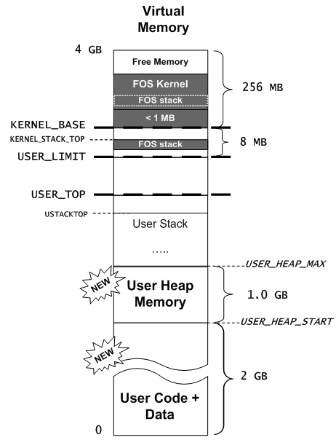
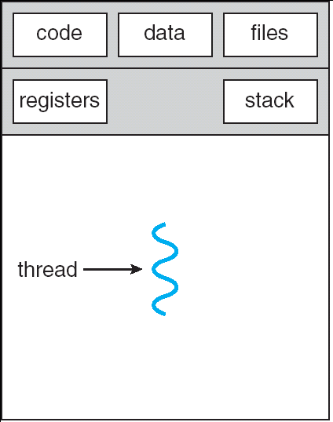
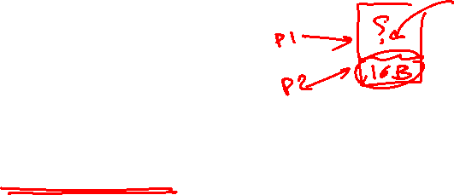
Shared Memory: Overview
Communication is harder between processes
To allow it: shared memory is applied
Create and share objects in the PAGE ALLOCATOR of USER HEAP
FIRST FIT Strategy
Shared
Single-Threaded Process
Single-Threaded Process

Slide 79

Shared Memory: Overview
Creation (Application 1):
int* ptr_sharedInt;
uint8 isWritable = 1;
ptr_sharedInt = smalloc(“mySharedInt”,4,isWritable);
allocate 4 bytes named “mySharedInt” in virtual memory and return the allocated virtual address to “ptr_sharedInt”
Specify its shared permission to be writable
*ptr_sharedInt = 70;
Set the value of the shared int to 70

Slide 80

Shared Memory: Overview
Access from other app. (Application 2):
int* ptr_sharedInt;
ptr_sharedInt = sget(App1ID, “mySharedInt”);
Search for the shared object, named “mySharedInt” and belong to App1ID
share it in app2, and return its virtual address in “ptr_sharedInt”
int sharedInt = *ptr_sharedInt;
Read its value (it should be 70)

Slide 81

Shared Memory: Overview
Create/Share pages on 4KB granularity
.
.
.
ptr3 = sget(ownerID, “z”)
ptr3
3 KB
ptr2 = smalloc(“y”, 1 KB, 0)
ptr2
1 KB
2 KB
4 KB
ptr1 = smalloc(“x”, 6 KB, 1)
ptr1
PAGE ALLOCATOR
.
.
.
USER_HEAP_START

Slide 82
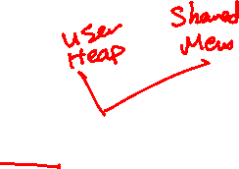
Shared Memory: Overview
FIRST FIT Strategy
.
.
.
USER_HEAP_MAX
2 MB
.
.
.
z = sget(ownerID, “z”)
2 MB
z
1 MB
ptr3 = malloc (1 MB)
ptr2
1 MB
3 MB
4 MB
ptr2 = malloc (3 MB)
ptr1
2 MB
y = smalloc(“y”,1.5MB,0)
y
1.5 MB
3 MB
x = smalloc(“x”, 1 MB, 1)
x
1 MB
4 MB
PAGE ALLOCATOR
.
.
.

Slide 83
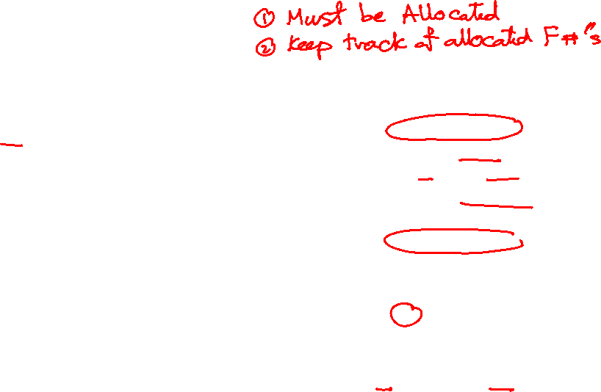
Shared Memory: Details
smalloc(): Store allocated frames for later use
x = smalloc(“x”, 6 KB, 1)
Share Object 1
y = smalloc(“y”, 2 KB, 1)
Virtual.1
RAM
OwnerID=Env1ID,
Name = “x”, Size = 6 KB, …
.
.
.
…
100
30
Frames Storage
Share Object 2
OwnerID=Env1ID,
Name = “y”, Size = 2 KB, …
y
2 KB
…
4 KB
4 KB
F# 100
99
Frames Storage
2 KB
F# 99
2 KB
4 KB
…
PAGE ALLOCATOR
x
30
99
100
.
.
.
...
R=1
…….
R=1
R=1
...
2 KB
F# 30
frames_info
…

Slide 84
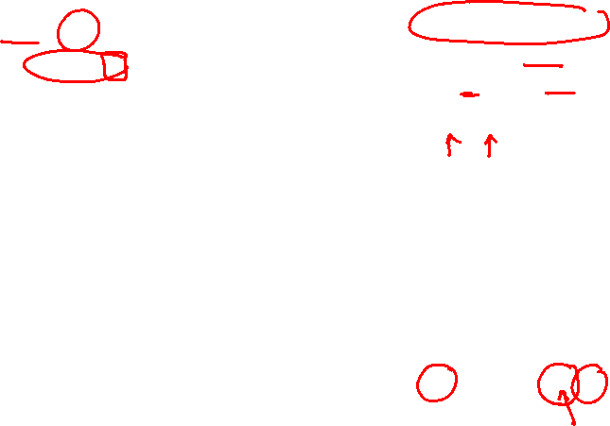
Shared Memory: Details
sget(): Share the stored frame of the object.
Share Object 2
[Virt.2] y2 = sget(env1ID, “y”)
Share Object 1
[Virt.2] x2 = sget(env1ID, “x”)
[Virt.3] y3 = sget(env1ID, “y”)
OwnerID=Env1ID,
Name = “x”, Size = 6 KB, …
Virtual.1
Virtual.2
OwnerID=Env1ID,
Name = “y”, Size = 2 KB, …
Virtual.3
RAM
.
.
.
.
.
.
.
.
.
…
Frames Storage
100
Frames Storage
99
30
y
2 KB
4 KB
4 KB
F# 100
2 KB
4 KB
F# 99
2 KB
x2
2 KB
2 KB
y3
4 KB
4 KB
…
x
y2
2 KB
30
99
100
.
.
.
.
.
.
.
.
.
...
R=1
…….
R=1
R=1
...
R=2
R=3
R=2
R=2
2 KB
F# 30
frames_info
…

Slide 85

Shared Memory: Data [GIVEN]
struct Share
{
//Unique ID for this Share object
//Should be set to VA of created object after masking most significant bit (to make it +ve)
int32 ID ;
char name[64]; //share name
int32 ownerID ; //ID of the owner environment
int size; //share size
uint32 references; //references, number of envs looking at this shared mem object
uint8 isWritable; //sharing permissions (0: ReadOnly, 1:Writable)
struct FrameInfo** framesStorage; //to store frames to be shared
LIST_ENTRY(Share) prev_next_info; // list link pointers
}
kern/mem/shared_memory_manager.h

Slide 86

Shared Memory: Data [GIVEN]
kern/mem/shared_memory_manager.h
//List of all shared objects
LIST_HEAD(Share_List, Share); // Declares 'struct Share_List’
struct
{
struct Share_List shares_list ; //List of all share variables created by any process
struct spinlock shareslock; //Use it to protect the shares_list in the kernel
} AllShares;
GENERAL NOTE: make sure to protect shares_list using its lock

Slide 87

Shared Memory: Functions [GIVEN]
kern/mem/shared_memory_manager.c
void sharing_init(uint32 numOfElements) (DONE)
Initialize the shares list & its lock
ALREADY called for you ☺
int getSizeOfSharedObject(int32 ownerID, char* shareName) (DONE)
Get the size of the shared object

Slide 88

#16: Alloc & Initialize Share Object
kern/mem/shared_memory_manager.c
inline struct FrameInfo** create_frames_storage(int numOfFrames)
struct Share* create_share(int32 ownerID, char* shareName, uint32 size, uint8 isWritable)
Create an array of pointers to struct FrameInfo of size numOfFrames
Initialize it by ZEROs
Return:
If succeed: pointer to the created array
If failed: NULL
Testing:
Will be tested during the other tests…
Allocate a new shared object
Initialize its members:
references = 1,
ID = VA of created object after masking msb
Create the "framesStorage"
Return:
If succeed: pointer to the created object for struct Share
If failed: UNDO any allocation & return NULL
Testing:
Will be tested during the other tests…

Slide 89
#17: Search for Share Object
kern/mem/shared_memory_manager.c
Search for shared object with the given “ownerID” & “name” in the “shares_list”
Return:
If found: pointer to the Share object
Else: NULL
Testing:
Will be tested during the other tests…
struct Share* get_share(int32 ownerID, char* name)

Slide 90

#18: smalloc()
[USER SIDE] lib/uheap.c
Apply FIRST FIT strategy to search the PAGE ALLOCATOR in user heap for suitable space to the required allocation size (on 4 KB BOUNDARY)
if no suitable space found, return NULL
Call sys_createSharedObject(...) to invoke the Kernel for allocation of shared variable
RETURN:
If successful, return its virtual address
Else, return NULL
Testing:
FOS> run tshr1 3000 ➔ smalloc
FOS> run tshr3 3000 ➔ smalloc (special cases)
void* smalloc(char *sharedVarName, uint32 size, uint8 isWritable)

Slide 91

#19: createSharedObject()
[KERNEL SIDE] kern/mem/shared_memory_manager.c
int createSharedObject(int32 ownerID, char* shareName, uint32 size, uint8 isWritable, void* virtual_address)
Allocate & Initialize a new share object
Add it to the “shares_list”
Allocate ALL required space in the physical memory on a PAGE boundary
Map them on the given "virtual_address" on the current process with WRITABLE permissions
Add each allocated frame to "frames_storage" of this shared object to keep track of them for later use
RETURN:
ID of the shared object (its VA after masking out its msb) if success
E_SHARED_MEM_EXISTS if the shared object already exists
E_NO_SHARE if failed to create a shared object

Slide 92

#20: sget()
[USER SIDE] lib/uheap.c
Get the size of the shared variable (use sys_getSizeOfSharedObject())
If not exists, return NULL
Apply FIRST FIT strategy to search the heap for suitable space (on 4 KB BOUNDARY)
if no suitable space found, return NULL
Call sys_getSharedObject(...) to invoke the Kernel for sharing this variable
RETURN:
If successful, return its virtual address
Else, return NULL
Testing:
FOS> run tshr2 3000 ➔ smalloc & sget
FOS> run tff3 3000 ➔ First Fit (smalloc, sget, malloc & free)
void* sget(int32 ownerEnvID, char *sharedVarName)

Slide 93

#21: getSharedObject()
[KERNEL SIDE] kern/mem/shared_memory_manager.c
Get the shared object from the "shares_list"
Get its physical frames from the “frames_storage”
Share these frames with the current process starting from the given "virtual_address"
Use the flag isWritable to make the sharing either read-only OR writable
Update references
RETURN:
ID of the shared object (its VA after masking out its msb) if success
E_SHARED_MEM_NOT_EXISTS if the shared object is NOT exists
int getSharedObject(int32 ownerID, char* shareName, void* virtual_address)

Slide 94
BONUS#4: Delete Shared Object
[USER SIDE] lib/uheap.c
void sfree(void* virtual_address)
Find the ID of the shared variable at the given address
Call sys_freeSharedObject() to free it
Testing:
FOS> run tshr4 3000 ➔ smalloc & sfree
FOS> run tshr5 3000 ➔ smalloc , sget & sfree

Slide 95

BONUS#4: Delete Shared Object
[KERNEL SIDE] kern/mem/shared_memory_manager.c
void free_share(struct Share* ptrShare)
Delete the give share object from the "shares_list"
Delete the "framesStorage" and the shared object itself

Slide 96

BONUS#4: Delete Shared Object
[KERNEL SIDE] kern/mem/shared_memory_manager.c
int freeSharedObject(int32 sharedObjectID, void *startVA)
Get the shared object from the "shares_list"
Unmap it from the current process
If page table(s) become empty, remove it
Update references
If this is the last share, delete the share object (use free_share())
Flush the cache

Slide 97

Shared Memory: Testing
"test [TEST NAME] completed. Evaluation = …%”
To ensure the success of a test, this message like this MUST be appeared without any ERROR messages or PANICs.
Test each function in MS2 independently in a FRESH SEPARATE RUN.
The time limit of each individual test: max of 30 sec / each
# | Function | Test
1 | smalloc & createSharedObject tst_sharing_1.c (tshr1): It tests the creation of shared objects. It validates the returned addresses and the number of allocated frames. It also checks the memory access (read & write) of the created shared objects. | FOS> run tshr1 3000
2 | smalloc & createSharedObject tst_sharing_3.c (tshr3): It tests handling the special cases of shared objects creation. Namely, creating objects with same name, creating large object that exceeds heap area and creating large number of objects that exceed the max allowed objects. | FOS> run tshr3 3000
3 | smalloc, createSharedObject, sget & getSharedObject tst_sharing_2master.c (tshr2): It tests the request for sharing object. It validates the returned addresses & the number of allocated frames. It also checks the mem. access (read & write) of the retrieved shared objects with different read/write permissions. | FOS> run tshr2 3000
4 | smalloc, createSharedObject, sget & getSharedObject, malloc & free tst_first_fit_3.c (tff3): tests the first fit strategy by requesting normal and shared allocations that always fit in one of the free segments. All requests should be granted. | FOS> run tff3 3000

Slide 98
Shared Memory: BONUS Testing
Test | Test Functionality
FOS> run tshr4 3000 | tst_sharing_4.c: Tests the free of shared object after creating it.
FOS> run tshr5 3000 | tst_sharing_5_master.c: Tests the free of shared object after creating & getting it.

Slide 99

Agenda
Logistics
Part 0: Code Updates
Part 1: Kernel Heap
Block Allocator
Page Allocator
Part 2: Fault Handler I
Part 3: User Heap
Block Allocator
Page Allocator
Part 4: Shared Memory
Summary & Quick Guide
How to submit?

Slide 100

Summary
Module | Function | Diff | Testing | Files
Kernel Heap | Initialization | L1 | Will be tested during the other tests… | kern/mem/kheap.h & kern/mem/kheap.c
 | sbrk() | L2 | FOS> tst kheap FF sbrk ➔ tests sbrk & allocate
System Calls | kmalloc (FIRST FIT) | L3 | FOS> tst kheap FF kmalloc 1 ➔ tests allocation only FOS> tst kheap FF kmalloc 2 ➔ tests FF in PAGE Alloc FOS> tst kheap FF kmalloc 3 ➔ tests FF in PAGE & BLK 2 & 3 depend on kfree | kern/mem/kheap.c
 | kfree | L2 | FOS> FOS> tst kheap FF kfree
 | kheap_virtual_address | L1 | FOS> FOS> tst kheap FF kvirtaddr
 | kheap_physical_address | L1 | FOS> FOS> tst kheap FF kphysaddr
 | (+) krealloc() | (L3) | UNSEEN – Test at your own
 | (+) Fast Page Allocator | (L3) | FOS> tst kheap FF fast (should run in < 5 sec)
"test [TEST NAME] completed. Evaluation = …%”
To ensure the test success, this message like this MUST appear without any ERROR messages or PANICs.

Slide 101
Summary
Module | Function | Diff | Testing | Files
Fault Handler | Kernel Dyn. Alloc for a Process | L1 | Already tested in Placement test | kern/mem/working_set_manager.c kern/proc/user_enviornment.c
 | Check Invalid Pointers | L1 | FOS> run tia 15 | Kern/trap/fault_handler.c
 | page_fault_handler | L2 | FOS> run tpp 20 | Kern/trap/fault_handler.c
"test [TEST NAME] completed. Evaluation = …%”
To ensure the test success, this message like this MUST appear without any ERROR messages or PANICs.

Slide 102
Summary
Module | Function | Diff. | Testing | Files
User Heap | Initialization | L1 | Will be tested during the other tests | inc/environment_definitions.h kern/proc/user_environment.c
 | sys_sbrk() | L2 | UNSEEN – Test at your own | [USER SIDE] lib/uheap.c [KERNEL SIDE] kern/mem/chunk_operations.c
System Calls | malloc (FIRST FIT) | L3 | FOS> run tm1 3000➔ malloc PAGE ALLOC FOS> run tm2 3000➔ malloc BLOCK ALLOC FOS> run tf1 3000➔ free PAGE ALLOC FOS> run tf2 3000➔ free BLOCK ALLOC FOS> run tff1 3000➔ FF PAGE ALLOC FOS> run tff2 10,000➔ FF BLOCK ALLOC
 | allocate_user_mem() | L1
 | free | L2 | FOS> FOS> tst kheap FF kvirtaddr
 | free_user_mem() | L2 | FOS> FOS> tst kheap FF kphysaddr
 | (+) O(1) free_user_mem | (L2) | UNSEEN – Test at your own
"test [TEST NAME] completed. Evaluation = …%”
To ensure the test success, this message like this MUST appear without any ERROR messages or PANICs.

Slide 103
Summary
Module | Function | Diff. | Testing | Files
Shared Memory | Alloc & Initialize Share Object | L2 | Will be tested during the other tests | [USER SIDE] lib/uheap.c [KERNEL SIDE] kern/mem/shared_memory_manager.c
 | Search for Share Object | L1 | Will be tested during the other tests
System Calls | smalloc() (FIRST FIT) | L2 | FOS> run tshr1 3000 ➔ smalloc FOS> run tshr2 3000 ➔ smalloc & sget FOS> run tshr3 3000 ➔ smalloc (special cases) FOS> run tff3 3000 ➔ FF: smalloc, sget, malloc, free
 | createSharedObject() | L2
 | sget() (FIRST FIT) | L2 | FOS> FOS> tst kheap FF kvirtaddr
 | getSharedObject() | L1 | FOS> FOS> tst kheap FF kphysaddr
 | (+) Delete Shared Object (sfree(), free_share(), freeSharedObject() | (L3) | FOS> run tshr4 3000 ➔ smalloc, sfree FOS> run tshr5 3000 ➔ smalloc, sget, sfree
SUMMARY: L1 ➔ 9 FUNCTIONS - L2 ➔ 10 FUNCTIONS - L3 ➔ 2 FUNCTIONS
"test [TEST NAME] completed. Evaluation = …%”
To ensure the test success, this message like this MUST appear without any ERROR messages or PANICs.

Slide 104

REMEMBER:
UPDATE YOUR CODE ACCORDING TO PREVIOUSLY DESCRIBED STEPS
READ ATATCHED APPENDICES FOR HELPER FUNCTIONS.

Slide 105
DEBUGGING:
Debug via breakpoints (ECLIPSE) [link]
Debug via printing [link: 1st minute]
Locate the line causing exception via disassembly [link]

Slide 106
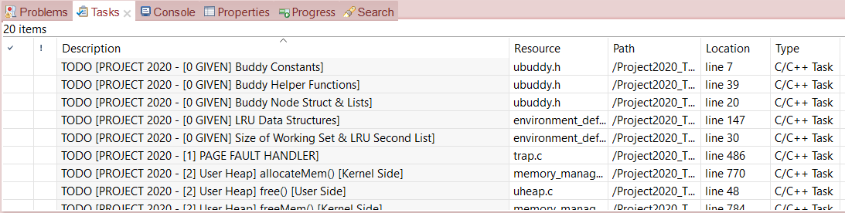
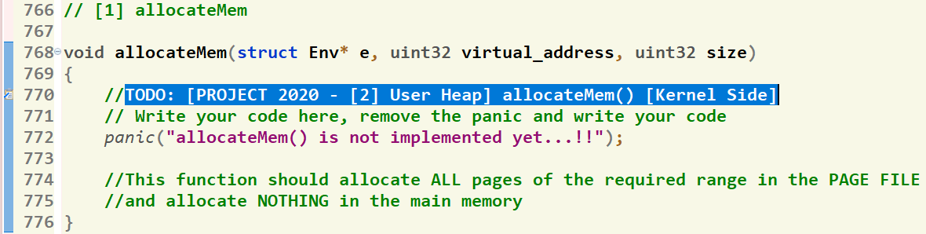
Where should I write the Code?
There’re shortcut links that direct you to the function definition
[1] Click on “Tasks” Tab
[2] Double Click on the required function
GIVEN
REQUIRED
[3] Function body, at which you should write the code
106

Slide 107
Agenda
Logistics
Part 0: Code Updates
Part 1: Kernel Heap
Block Allocator
Page Allocator
Part 2: Fault Handler I
Part 3: User Heap
Block Allocator
Page Allocator
Part 4: Shared Memory
Summary & Quick Guide
How to submit?

Slide 108

Submission Rules
Read the following instructions as the code correction is done AUTOMATICALLY. Any violation in these rules will lead to 0 and, in this case, nothing could be happened.
First ensure the following that (READ CAREFULLY):
You tested each function in a FRESH RUN and a congratulations message have been appeared.
NO CODE with errors WILL BE CORRECTED. So, CLEAN & RUN your project several times before your submission.
You submitted BEFORE the deadline by several hours to AVOID any internet problems.
DEADLINE: THU of Week #9 (28/11 @11:59 PM)
NO DELAYED submissions WILL BE ACCEPTED.
ONLY ONE person from the team shall submit the code.
The TEAM # MUST BE CORRECT.
DON’T take the FORM LINK FROM ANYONE. OPEN the form from its LINK ONLY. Otherwise, your submission is AUTOMATICALLY CANCELLED by GOOGLE.
You MUST RECEIVE A MAIL FROM GOOGLE with your submission after clicking submit. If nothing received, re-submit again to consider your submission.

Slide 109

Submission Steps
STEPS to SUBMIT:
Step 1: Clean & run your code the last time to ensure that there are any errors.
Step 2: Create a new folder and name it by your team number ONLY. Example 1 or 95. [ANY extra chars will lead to 0].
Step 3: DELETE the “obj” folder from the “FOS_PROJECT_2024_Template”
Step 4: PASTE the “FOS_PROJECT_2024_Template” in the folder created in step #2.
Step 5: Zip the created new folder. Its name shall be like [num of your team.zip]. [ANY extra chars will lead to ZERO].
Step 6: Open the form from HERE.
Step 7: Fill your team’s info .. Any wrong information will cancel your submission, revise them well.
Step 8: Upload the zipped folder in step 5 to the form in its field.
Step 9: MUST RECEIVE A MAIL from GOOGLE with your submission, otherwise re-submit again.

Slide 110
Thank you for your care…
Enjoy making your own FOS ☺

